Slide 1
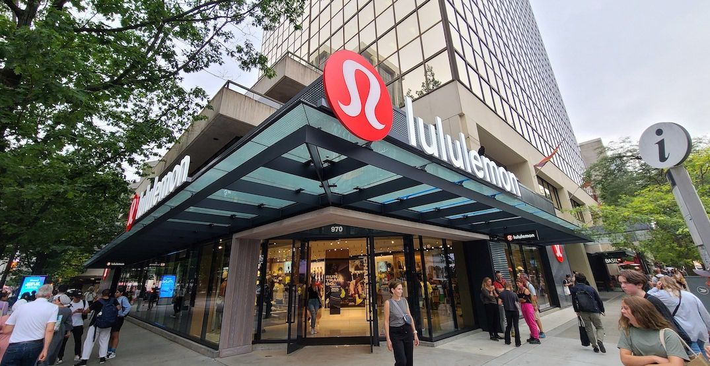

EXECUTIVE OVERVIEW
Lululemon Athletica Inc. | BUY: 56.3% Upside
(NASDAQ: LULU)
Max Chen, Eric Tao, Michael Weng, Dylan Woolstencroft
December 31, 2025

Slide 2





Team Fantastic Four
Max Chen, Eric Tao, Michael Weng, Dylan Woolstencroft
Max Chen
Eric Tao
Michael Weng
Dylan Woolstencroft
First Year - Western
First Year - Stern
First Year - Sauder
First Year - Sauder
Fantastic Four | SCMC 2025 - Round 1

Slide 3
Investment Summary
Significant mispricing driven by short-term North American noise misses durable global growth
Rationale for Lululemon
Premium global brand with durable pricing power and a reset opportunity the market is misinterpreting
Lululemon remains a best-in-class premium athletic apparel platform with industry-leading margins, brand loyalty, and free cash flow.
Recent North American softness has been extrapolated by the market as structural, despite evidence pointing to fixable execution issues rather than demand erosion
Strong balance sheet and cash generation provide flexibility to invest through the reset while returning capital via buybacks
Underappreciated Earnings Reacceleration
North America reset (inventory discipline, merchandising cadence, leadership transition) creates a clear path to margin recovery and multiple re-rating
International expansion, led by China, follows a proven demand-first playbook that delivers faster sales per store and earlier margin normalization than street assumptions
Men’s category growth represents a structurally underpenetrated, higher-frequency demand driver with revenue growth consistently outpacing women’s and the broader apparel market
Recommendation
Buy Lululemon (NASDAQ: LULU) at $212.54 for an upside of 56.3% from current levels to reach a target price of $332.14
Market is overly discounting near-term North American execution risk while underestimating the earnings power of international scale, men’s category expansion, and operational normalization
Fantastic Four | SCMC 2025 - Round 1

Slide 4

EXECUTIVE OVERVIEW

Slide 5

COMPANY OVERVIEW

Slide 6
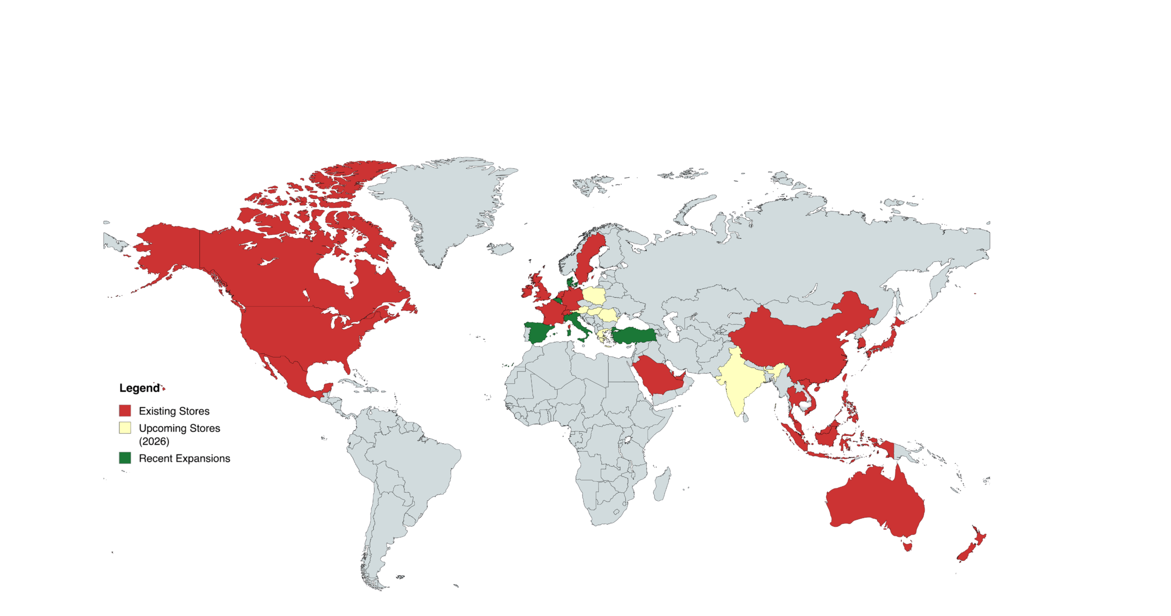



Company Overview
Lululemon Athletica is a premium apparel company focusing on selling a lifestyle
Business Description
Lululemon designs and sells performance apparel and accessories, leveraging brand loyalty to sustain premium pricing practices and repeat purchases.
Operates a Direct-to-Consumer (DTC) retail strategy globally, using physical locations as community hubs to drive engagement with exclusive events.
Maintains disciplined inventory and limited discounting, leading to industry-leading gross margins and strong free cash flow generation compared to peers.
International and category expansion (menswear, accessories, hiking and footwear) are core drivers, funded by revenue and complemented by share buybacks.
Key Financials
Geographic Breakdown
Ticker | NASDAQ: LULU
Share Price | $212.54
52 Week Low-High | $159.25 - $423.32
Adj. EBITDA Margin | 22%
TTM P/E | 14.77x
Existing
Upcoming
Recently Opened
Management
Meghan Frank
Americas account for 68-71% of revenue, but recent net revenue has decreased 2% in Q3 2025
Previously CFO, will serve as interim Co-CEO starting in Feb
Calvin McDonald
Mainland China now 18% of revenue, with
46% YoY growth in Q3 2025.
Stepping down as CEO due to recent performance issues
André Maestrini
Previously CCO, will serve as interim Co-CEO starting in Feb
ROW contributes 14-15% of revenue, growing 19-20% YoY, outpacing North America
Sources: Lululemon, Yahoo, Reuters
Fantastic Four | SCMC 2025 - Round 1

Slide 7
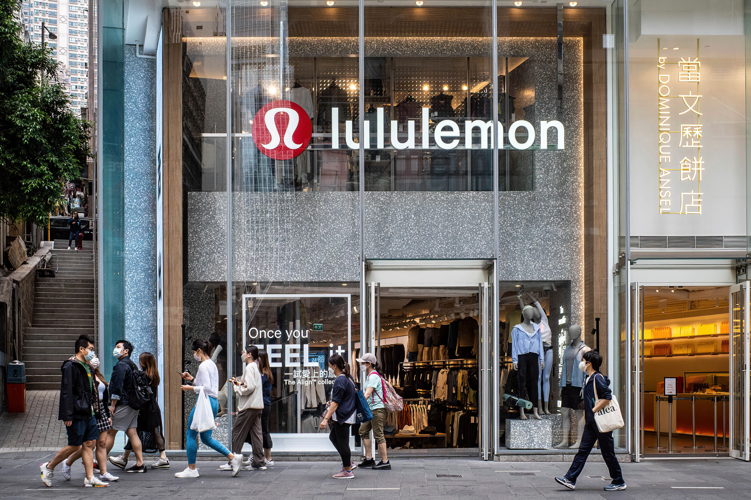
INVESTMENT THESES

Slide 8
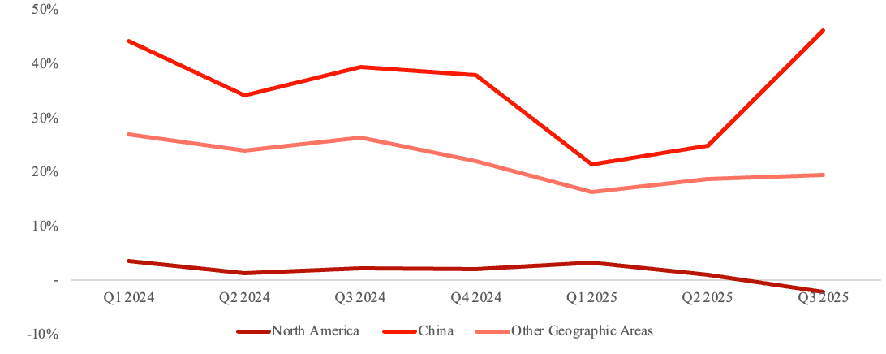
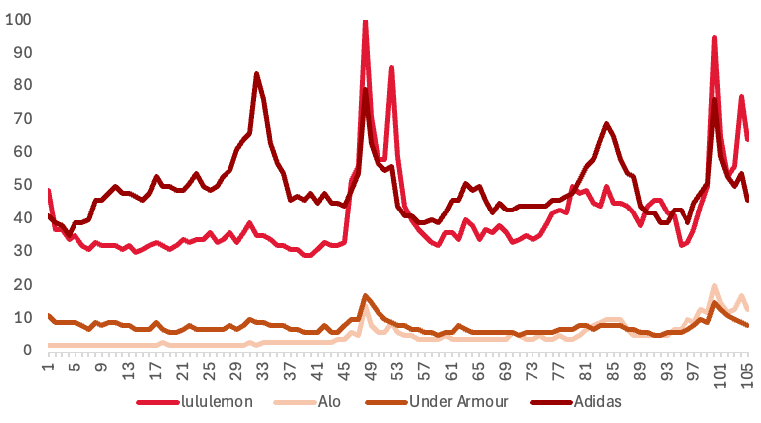
Thesis I: North America Reset Drives Re-Rate
Execution gap causing NA decline, structural integrity remains strong
Proven Brand Resilience Within International Markets, Lacking Domestically
YOY Revenue Growth by Region
1
Product Cadence and assortment are off in North America compared to ROW
2
Conversion Rates are Falling in NA, indicating poor merchandising
3
Price Markdowns are hurting margins and discounting premium-brand feel
Lululemon's stock fell due to fears of decaying market share in America's ass as top-line growth stalled out due to poor mgmt decisions
Street View Vs Our View
Web Traffic Confirms Demand Remains Intact
The market is pricing in limited growth for Lululemon in 2026 because it views North America as increasingly saturated. From this perspective, the recent revenue stall reflects structural deceleration, with intensifying competition weakening pricing power and pressuring market share.
Website Traffic Visits
Weekly Relative Website Traffic Since 2023 (NA)
Across the athleisure set, Lululemon continues to command a meaningful share of online traffic/interest, which is a strong signal that brand relevance and consumer intent in North America remains intact.
Street
Extreme Visits during sale periods + holidays
Conversion Gap
Despite resilient top-of-funnel demand, North America's revenue softness suggests a conversion and merchandising leak, not a collapse in consumer interest.
Lululemon continues to perform strongly internationally, and the recent softness in North America is better explained by fixable execution missteps than by any structural deterioration in the market. With targeted operational adjustments, the business can re-accelerate and regain momentum.
Our View
Surge Demand During Q4
Extreme Holiday / Black Friday surges indicates that shoppers' demand hasn’t disappeared; instead, it has become more timing and value-sensitive.
Sources: Lululemon public filings, Yahoo Finance, Bloomberg Analyst Recommendations, Google Trends
Fantastic Four | SCMC 2025 - Round 1

Slide 9
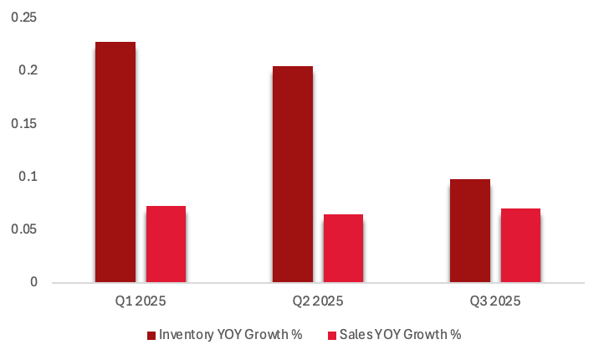

Thesis I: North America Reset Drives Re-Rate
Refreshed leadership group and returned capital to drive future growth
Excess Inventory Creates a Clear Reset Lever for Margin Recovery
Why the Poor Ratio?
Short-term
Higher markdowns to clear excess product, which pressures gross margin and drags earnings.
Inventory is outpacing sales, showcasing a poor product management
1
Inventory outpacing sales suggests Lululemon is producing too much product relative to demand.
Products are not resonating with customers, leading to longer inventory sell-through
2
Long-term
High inventory can act as a reset lever: tightens buys, clear excess with targeted markdowns, then drive margin recovery as sell-through normalizes.
3
pricing is too high to clear product at full price, slowing sell-through.
... we have reasons to believe Lululemon is at an inflection point
Recent Activist $1 Billion Investment
CEO Refresh Coming at Perfect Time
Calvin McDonald (set to retire Jan 2026)
Earnings Call (Q3 2025) - CEO
Inherent Benefits:
strongly growth-oriented leadership style but too slow to course-correct on North America product and inventory discipline, allowing execution slippage to persist longer than it should have.
“We are beginning to make progress against our action plan and continue to expect to see the impact of this work in 2026.”
1
raises urgency around leadership and the North America reset, making it harder for management to “wait it out”
Jane Nielson (Proposed Successor by Elliot)
2
drives clearer KPIs (inventory discipline, markdown rates, etc.) + tighter follow-through
A high-discipline operator with premium apparel experience who can tighten product and execution while restoring margin focus, with Credible prior senior roles
"Lululemon is one of the most powerful brands in retail, defined by exceptional products [and] deeply engaged communities"-Jane Nielson (Dec 18th, 2025)
Buy-back promise in Q3
First time stock price >200 since Aug 2025
$1 Billion
3
increases the probability of disciplined capital returns and sharper resource allocation
Catalysts
A
CEO and Strategic Reset Implements Jan 2026
B
Elliot's Board Ideas are Supported
Sources: Lululemon public company filings, Elliot Investment Management, Reuters
Fantastic Four | SCMC 2025 - Round 1

Slide 10
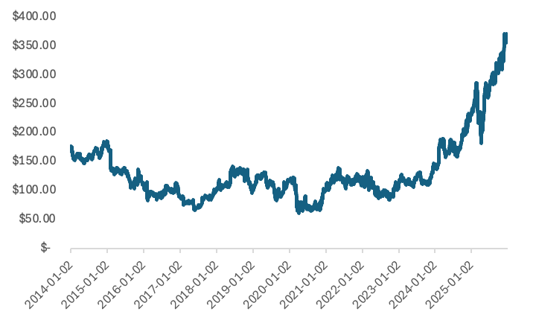
Precedent Case Study Ralph Lauren (NYSE:RL)
Notable similarities exist between Ralph Lauren and Lululemon's operating model before leadership reset
Pre-Turn Around Similarities
Ralph Lauren Stock Re-Rate
Lululemon
Ralph Lauren
Market Segment
Premium, Higher Quality
New Leadership Group
>400% Rally (>20% CAGR)
Drawback from highs
Supply Chain
Vertically Integrated
Wholesale Oriented
Sales by Region
North America stalling, International Continuing strong
Ralph Lauren’s downturn initially looked structural, but it was largely an execution problem driven by inventory/SKU bloat, heavier discounting, and margin pressure in its core market. After a multi-year drawdown, RL launched its “Way Forward” plan alongside a leadership transition that restored urgency and accountability.
SKU Quantity
Too many products, creating bloated inventory
Product Differentiation
Products are too predictable
Set-Up:
Premium brand faced inventory overstock, rising competition, and declining margins that pressured investor confidence.
Catalyst:
“Way Forward” plan plus CEO transition created a clear reset moment with measurable operating targets.
Outcome:
Inventory discipline, improved full-price mix, and faster supply chain execution drove margin recovery + stock re-rate.
In-store Experience
Certain stores over-performing, lots underperforming
Elliott’s recent stake in Starbucks preceded a CEO transition and accelerated an execution reset (NASDAQ: SBUX; investment in 2024) very similar to Ralph Laurens
Ralph Lauren’s “Way Forward” turnaround shows that when a premium brand pairs leadership change with disciplined execution on inventory, assortment, and distribution, performance can re-accelerate, and the stock can re-rate.
Sources: Lululemon, Ralph Lauren, Yahoo Finance, Elliot Investment Management, Starbucks public filings
Fantastic Four | SCMC 2025 - Round 1

Slide 11
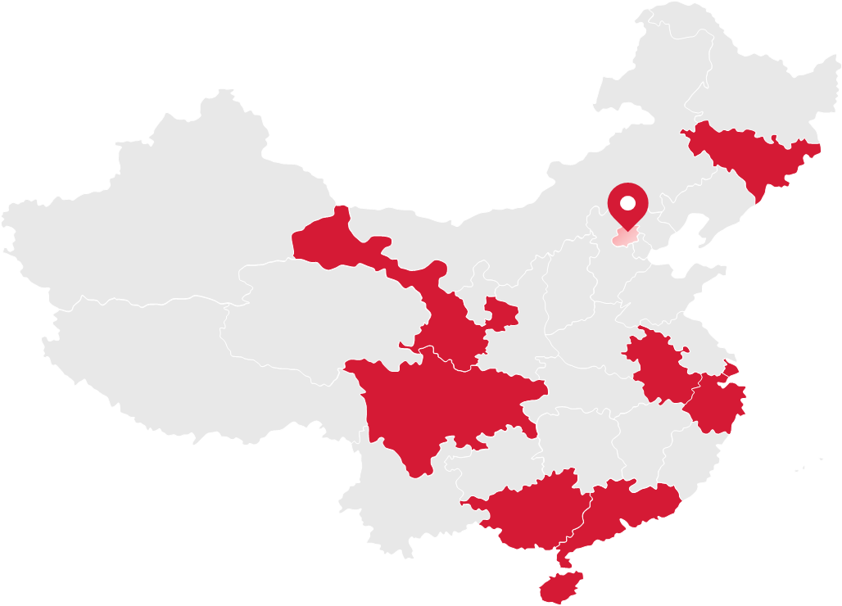
Thesis II: International and Men's Expansion Drive Next Leg of Growth
Lululemon enters markets after demand exists, not to create it
China as the Blueprint for Global Scaling
Why China has been a Successful Market?
Three-Step Growth Engine
Digital-First Demand Validation
Lululemon’s China entry followed deliberate steps refined over prior international expansions (Australia, UK, select Asia)
Management prioritized brand education and building community through in-store events early, allowing consumer perception to align with Lululemon’s premium pricing first before aggressive growth, creating demand-driven scarcity
Store rollout strategy avoided rapid national saturation, instead concentrating on high-density urban clusters, reducing the risk of cannibalization and improving store-level economics
The Chinese market proved that pricing power can be preserved, achieving comparable margins despite higher price points compared to local competitors
Density Unlocks Operating Leverage
Flagship-Led Brand Anchoring
1
China website traffic and social engagement scaled ahead of physical footprint, allowing for a low-capital demand test.
2
Tier-1 city flagships (Shanghai, Beijing, Guangzhou, Shenzhen) drive brand legitimacy, influencer attention, and drive conversion in surrounding regions
150+ stores in Mainland China
Revenue +46% YoY
Comparable sales +25% YoY across China stores
3
As store density grows, fulfillment costs decline, marketing efficiency improves, and full-price sell-through increases
Management targets revenue mix expanding from 20% → mid-30% long-term, implying a multi-year growth runway independent of NA
Sources: Lululemon, Yahoo Finance, China International Import Expo
Fantastic Four | SCMC 2025 - Round 1

Slide 12
Thesis II: International and Men’s Expansion Drive Next Leg of Growth
Concerns about North American declines are overblown — creating an opportunity the market misses
Fundamental Misunderstanding of Strategy
Variance from Street
Street’s skepticism around new country expansion is misjudged and based on outdated retail roll-out assumptions
Street Says
Linear Assumptions: Traditional assumptions model new country revenue slowly based on store productivity and profitability developing gradually and independently in each new market
Discount-Driven Bias: Forecasts implicitly assume that early-stage international stores require heavy promotional activity to drive traffic, leading to lower initial margin. In China, Lululemon is viewed as a premium lifestyle brand, allowing full-price sales
North America Contamination: Recent slowdowns in North America are being extrapolated into international assumptions. However, growth internationally is structurally different as penetration remains low and demand is still early in its cycle
“Store expansion in Canada and America slowing down”
“International ramp is gradual and dilutes margins”
Perceived decline in quality and struggles with young shoppers
We Say
New country expansion is not linear: Instead, growth is driven by validation of brand awareness through online access to shopping first, allowing revenue to accelerate as physical stores follow
Different product categories have a compounding effect: As popularity grows, incremental country expansion compounds beyond core women’s apparel as men’s, accessories, and footwear categories scale alongside the store base, increasing Average Transaction Value and Units per Sale for each store
Where Our Variance Exists
Street has misunderstood Lululemon’s global playbook
Lululemon looks to replicate and refine this strategy as they launch into the Indian market in 2026 (via Tata CLiQ)
Our model assumes faster sales per store growth and earlier margin normalization in new countries, driving a 24.8% variance in FY2030
Sources: Lululemon, NASDAQ, China International Import Expo
Fantastic Four | SCMC 2025 - Round 1

Slide 13
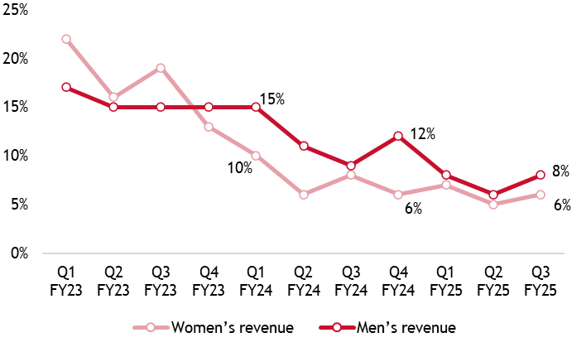
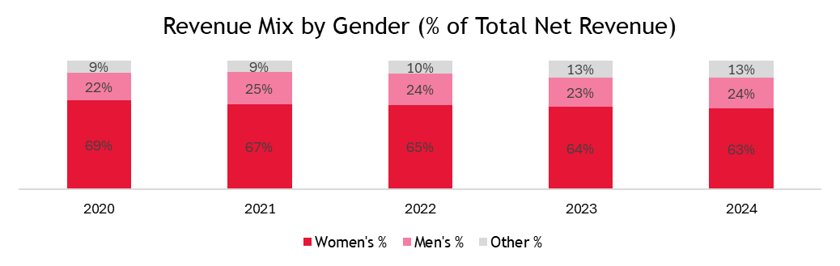
Thesis II: International and Men’s Expansion Drive Next Leg of Growth
Lululemon men’s line is a major growth driver in activewear, both domestically and internationally
Revenue Growth by Gender (% Growth, Quarterly)
Men’s Revenue Growth Consistently Outpaces Women’s
Lululemon’s men’s growth is not simply cyclical. The global trend of male participation in fitness and lifestyle apparel continues to expand and demand for premium product increases accordingly
Even in a decelerating macro consumer spending environment, men’s revenue has held up better than women’s, perhaps signaling that men are less price-sensitive and more loyal to technical offerings
Competitors struggle to match performance categories (run and golf)
Men’s revenue growth begins consistently surpassing Women’s
The global men’s activewear market is growing at 8.7% annually, expanding to US$240B by 2030, outpacing general apparel growth
Street View
Street claims that Vuori, Alo, Nike are targeting men aggressively, capping market share gains
Believes strength is temporary and not fundamental due to tariffs and inflation
Our View
Strategic moves like athlete partnerships and NHL merchandise increased awareness
Men’s demand in underpenetrated markets compounds domestic trends
Key Drivers
Secular Behaviour Shift in Male Apparel Consumption
Revenue Mix by Gender (% of Revenue)
Global Retail
Omni-Channel
Category Growth
International strategy forces adoption of men’s product lines
Omnichannel penetration allows for personalized engagement
Functional performance creates a moat and recurring sales
Sources: Lululemon Annual Reports, Statista, Grand View Research, NASDAQ
Fantastic Four | SCMC 2025 - Round 1

Slide 14

VALUATION

Slide 15
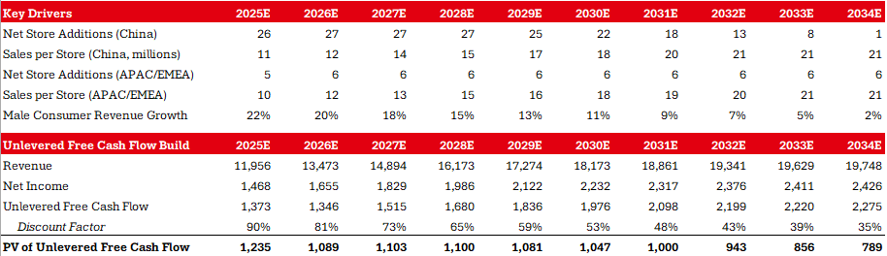
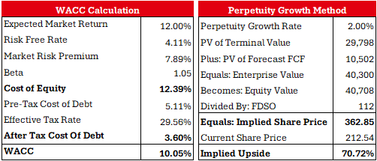
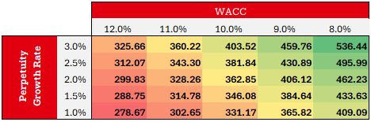
DCF Earnings Model – Base Case
Perpetuity (Gordon) Growth Method model yields an implied upside of 70.72%
Implied Share Price
Sources: Analysis, CapitalIQ
Fantastic Four | SCMC 2025 - Round 1

Slide 16
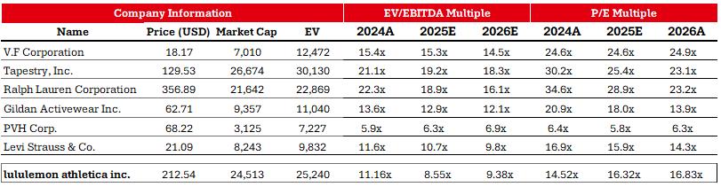
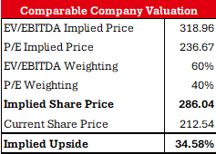
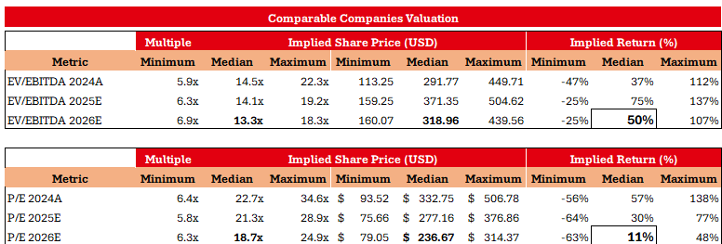
Comparable Companies Analysis
Comparable Companies Analysis yields an implied upside of 34.58%
Commentary:
The market over-penalizes LULU on P/E multiples, where it trades at 14.5x–16.8x forward, versus peers closer to the low-20s, largely due to SBC.
EV/EBITDA provides a cleaner reflection of true operating cash flow, supporting a higher intrinsic valuation.
Lululemon trades at a discount to premium global apparel peers despite strong fundamentals, margins, and brand strength, implying the market is underpricing its long-term earnings power.
Sources: Analysis, CapitalIQ
Fantastic Four | SCMC 2025 - Round 1

Slide 17
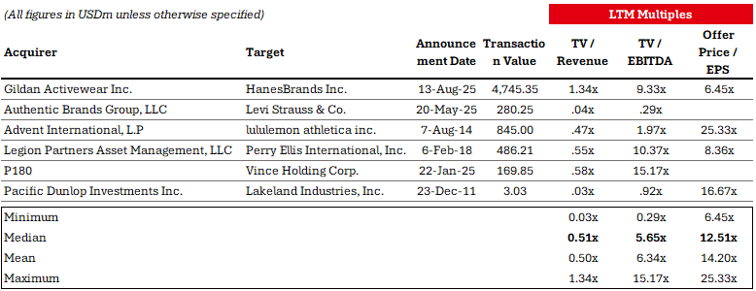
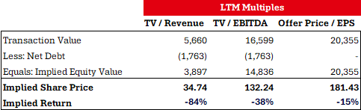
Precedent Transactions Analysis
Precedent Transactions are too small to reflect the value of a firm as large as Lululemon
Commentary:
Observed deals have median transaction values of ~$480mm, versus Lululemon’s ~$25bn enterprise value, making them orders of magnitude smaller and structurally incomparable
The median deal trades at ~0.5x TV/Revenue and ~5.7x TV/EBITDA, reflecting smaller or slower-growth businesses, rather than premium global brands with durable pricing power and scale like Lululemon
Therefore, we do not weigh precedent transactions whatsoever in our valuation.
Sources: Analysis, CapitalIQ
Fantastic Four | SCMC 2025 - Round 1

Slide 18

RISKS & CATALYSTS
RISKS AND CATALYSTS

Slide 19
Risks & Mitigations
We've identified three main risks that could impact Lululemon's future performance
Details
Mitigation
China represents ~13% of FY24 revenue but is growing ~40% YoY
A 5–10pp slowdown in China growth would reduce consolidated revenue growth by ~100–150 bps annually
Lululemon remains materially underpenetrated in China relative to Nike and adidas, with <200 stores vs. thousands for peers
Affluent customer base reduces exposure to demand volatility
Growth in China Underperforms Expectations
Men’s segment accounts for ~24% of FY24 revenue but is growing at ~14% YoY, outpacing women
If men’s growth converges to women’s growth (~9%), long-term revenue CAGR would decline by ~50–75 bps
Men’s revenue has nearly tripled since FY20, demonstrating proven product-market fit
Higher average unit economics in men’s apparel support profitability even at lower growth
Unsuccessful Integration of Menswear
A large chunk of Lululemon’s sourcing remains Asia-based, exposing COGS to tariffs and trade restrictions
Margin pressure would directly impact EBITDA
Diversified sourcing efforts reduce single-region dependency
Lululemon has historically passed through selective price increases without volume erosion due to brand strength
Trade Restrictions Threaten Asian Materials Sourcing
Sources: Analysis, CapitalIQ
Fantastic Four | SCMC 2025 - Round 1

Slide 20
Catalysts
Through strong performance, Lululemon can drive share price appreciation over an expansive time period
Lululemon has enough FCF capacity to resume and scale buybacks without constraining growth, driving immediate EPS accretion
Company spent 15.3% of Revenue on Share Buybacks in FY24A
Share repurchases at current valuation levels enhance per-share value and provide downside protection amid near-term volatility
Buyback Program Continuation & Returning Value to Shareholders
Short Term
New investment Leading to Improved Business Operations
Elliot Management has invested $1B thus far into Lululemon, planning to bring in Jane Nielsen as CEO
Nielsen has greatly improved efficiency and lowered costs as CFO at Coach, Inc. And COO at Ralph Lauren
Increased investment will spur store and product expansion
Medium Term
China and broader international expansion represent higher potential growth markets than North America
Growing international brand awareness and increasing store density will drive sales, reducing reliance on mature markets
Supports higher terminal growth as well
International Markets Provide Continued Growth Potential
Long Term
Sources: Analysis, CapitalIQ
Fantastic Four | SCMC 2025 - Round 1

Slide 21

APPENDIX

Slide 22
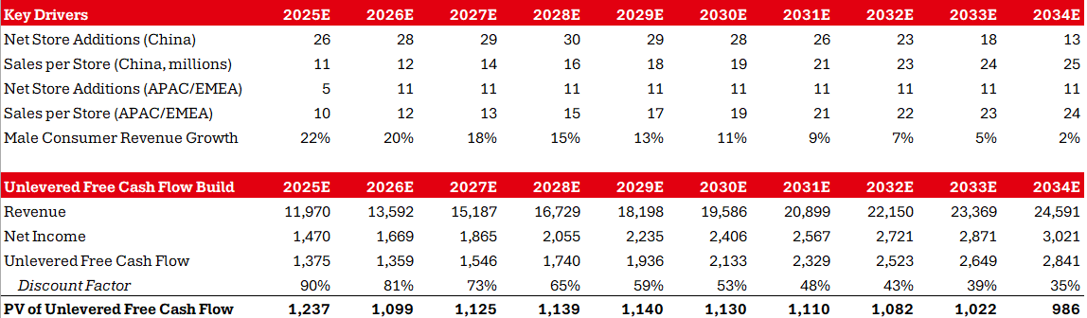
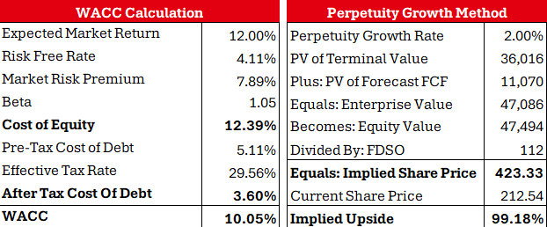
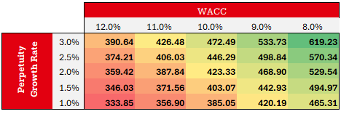
DCF Earnings Model – Bull Case
Our DCF (Bull Case) model yields an implied upside of 99.18%
Implied Share Price
Sources: Analysis, CapitalIQ
Fantastic Four | SCMC 2025 - Round 1

Slide 23
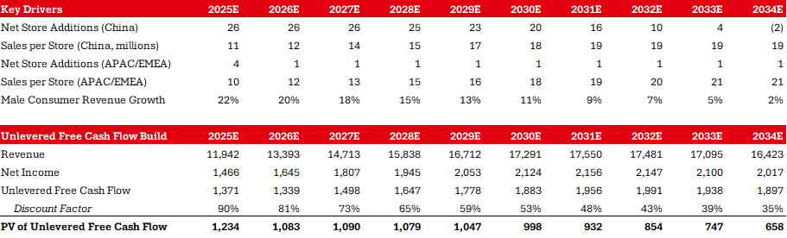

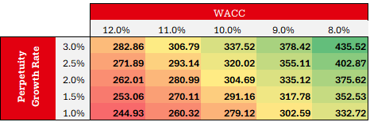
DCF Earnings Model – Bear Case
Our DCF (Bear Case) model yields an implied upside of 43.36%
Implied Share Price
Sources: Analysis, CapitalIQ
Fantastic Four | SCMC 2025 - Round 1

Slide 24
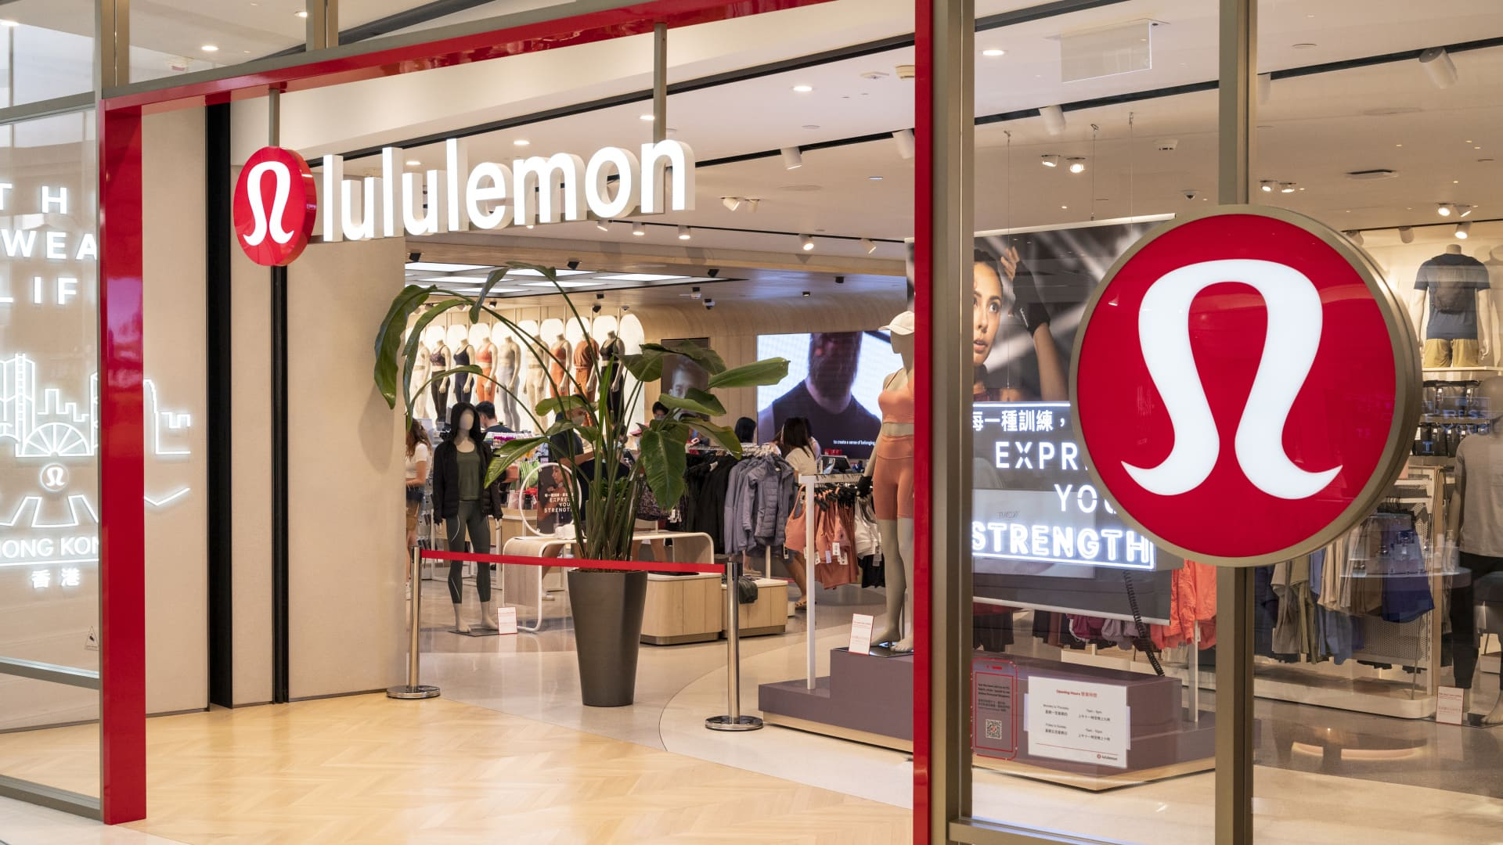
Lululemon Athletica Inc.
(NASDAQ: LULU)
Team Fantastic Four: Max Chen, Eric Tao, Michael Weng, Dylan Woolstencroft
December 31st, 2025
Fantastic Four | SCMC 2025 - Round 1​

